Slide 1
Parallel and Distributed Computing POSIX Threads(pthread) Programming
Kun Suo
Computer Science, Kennesaw State University
https://kevinsuo.github.io/

Slide 2
Outline
What is pthread?
Thread model
Pthread overview
Pthread management
Creation and termination
Identification
Join and detach
Pthread data sharing
Mutex
Condition variable
Barrier
Semaphore

Slide 3
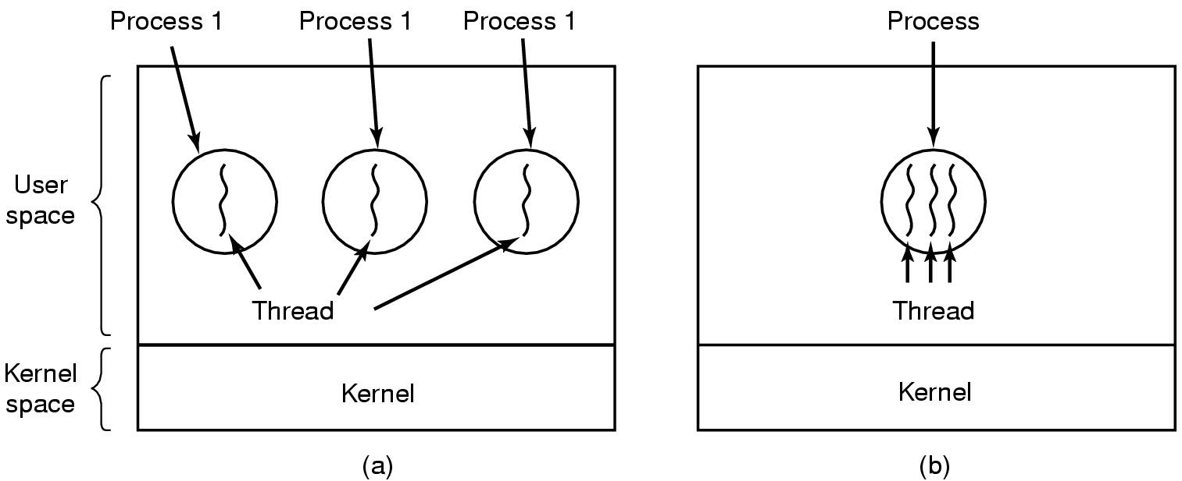
The Thread Model
Process: for resource grouping and execution
Thread: a finer-granularity entity for execution and parallelism
(a) Three processes each with one thread, but different address spaces
(b) One process with three threads, sharing the address space

Slide 4
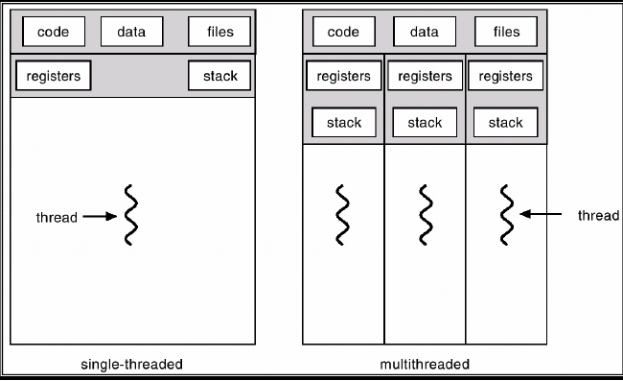
The Thread Model
Process | Thread
Have data/code/heap | Share code, data, heap
Include at lease one thread | Multiple can coexist in a process
Have own address space, isolated from other processes | Only have own stack and registers

Slide 5
Per process items | Per thread items
Address space Global variables Open files Child processes Pending alarms Signals and signal handlers Accounting information | Program counter Registers Stack State
Items shared by all threads in a process Items private to each thread

Slide 6
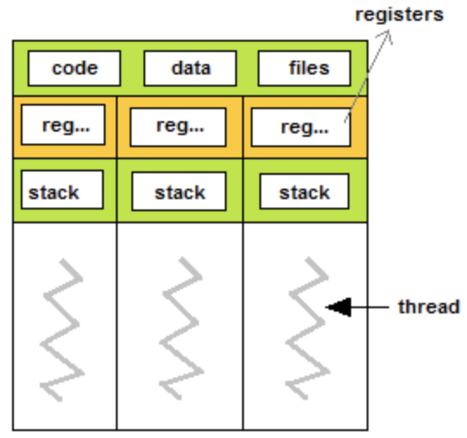
The Thread Model
Because threads within the same process share resources
Changes made by one thread to shared system resources (closing a file) will be seen by all other threads
Two pointers having the same value point to the same data
Reading and writing to the same memory location is possible, and therefore requires explicit synchronization by the programmer!
Shared resources
Three threads

Slide 7
Multi-threads for application performance
Dropped by 20x

Slide 8
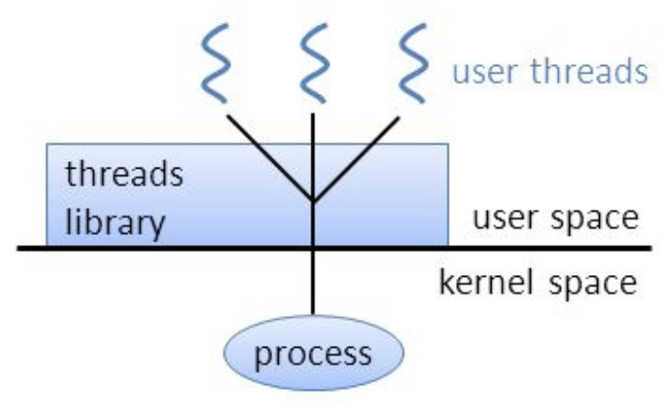
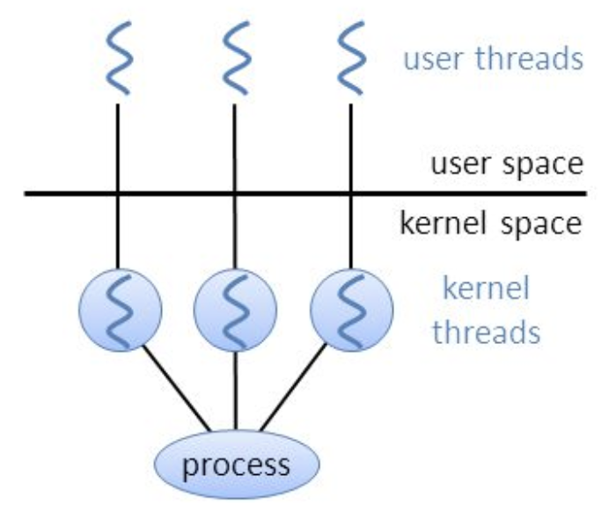
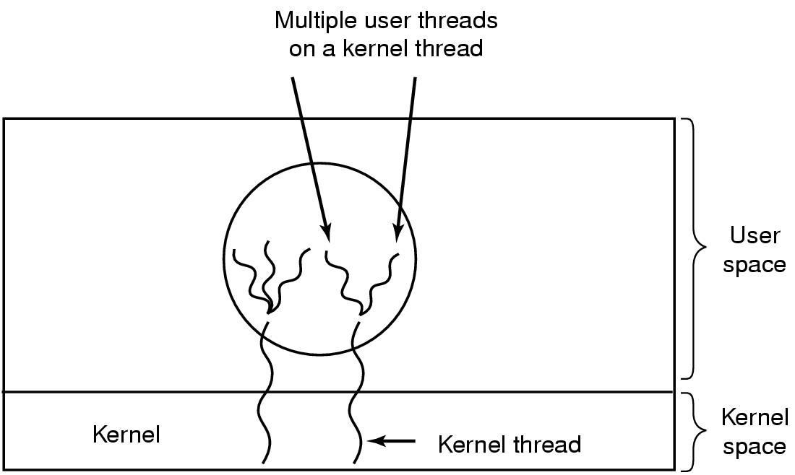
Threading Models
N:1 (User-level threading)
GNU Portable Threads
1:1 (Kernel-level threading)
Native POSIX Thread Library (Pthread)
M:N (Hybrid threading)
Solaris
https://www.gnu.org/software/pth/
https://en.wikipedia.org/wiki/Native_POSIX_Thread_Library
Linux/MacOS/Windows
https://www.oracle.com/solaris/solaris11/

Slide 9
Pthreads Overview
What are Pthreads?
An IEEE standardized thread programming interface (IEEE POSIX 1003.1c)
http://www.open-std.org/jtc1/sc22/WG15/
POSIX (Portable Operating System Interface) threads

Slide 10
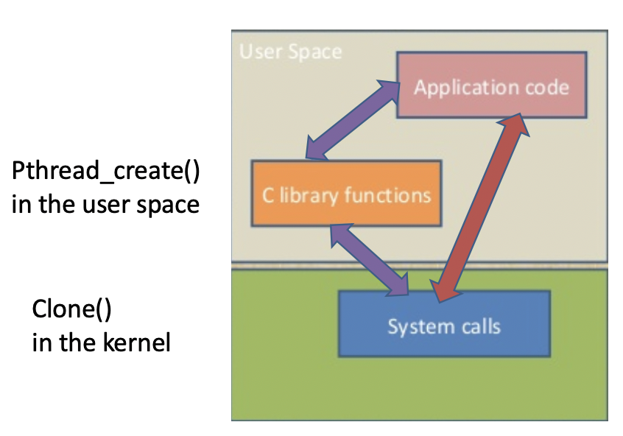

Pthreads Overview
What are Pthreads?
Defined as a set of C language programming types and procedure calls, implemented with a pthread.h header/include file and a thread library

Slide 11
Why Pthreads ?
Performance!
Lightweight
Communication
Fine granularity of concurrency
Easy to use
…

Slide 12
Why Pthreads ?
Time in second with running 50000 fork() or Pthread_create()
10~50 times faster
Platform | fork() |  |  | pthread_create()
 | real | user | sys | real | user | sys
IBM 1.9 GHz POWER5 p5-575 | 50.66 | 3.32 | 42.75 | 1.13 | 0.54 | 0.75
INTEL 2.4 GHz Xeon | 23.81 | 3.12 | 8.97 | 1.70 | 0.53 | 0.30
INTEL 1.4 GHz Itanium 2 | 23.61 | 0.12 | 3.42 | 2.10 | 0.04 | 0.01

Slide 13
Outline
What is pthread?
Thread model
Pthread overview
Pthread management
Creation and termination
Identification
Join and detach
Pthread data sharing
Mutex
Condition variable
Barrier
Semaphore

Slide 14
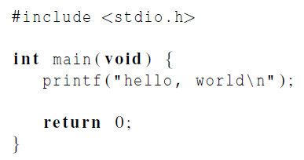
Hello World!
https://github.com/kevinsuo/CS3502/blob/master/hello-pthread.c

Slide 15
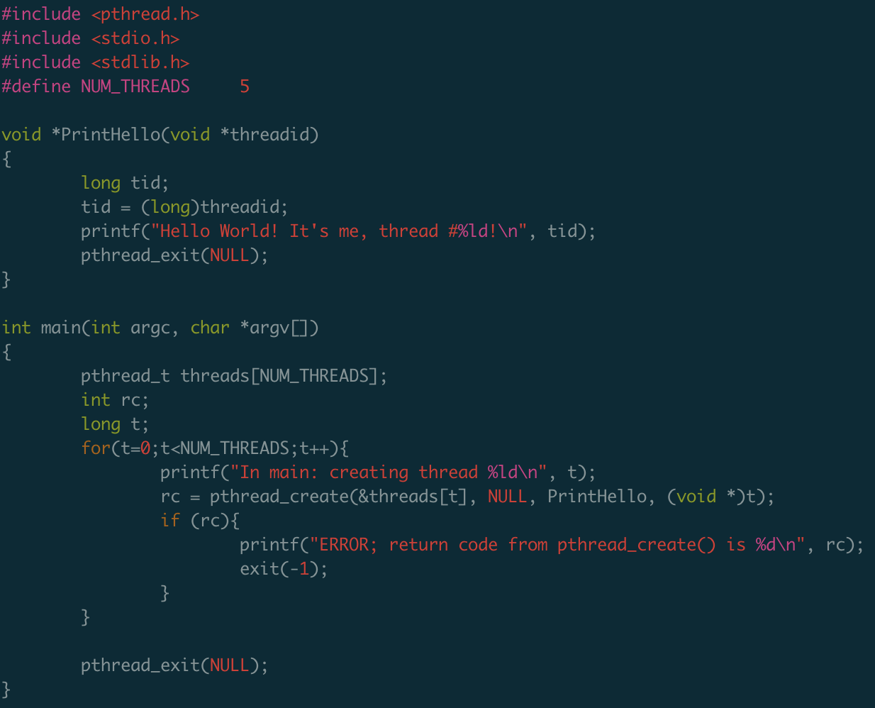
helloworld-pthread.c
Header file
What the thread will do?
Create new threads
Pthread exit

Slide 16
The Pthreads API
The API is defined in the ANSI/IEEE POSIX 1003.1 – 1995
Naming conventions: all identifiers in the library begins with pthread_
Three major classes of subroutines
Thread management, mutexes, condition variables
Routine Prefix | Functional Group
pthread_ | Threads themselves and miscellaneous subroutines
pthread_attr_ | Thread attributes objects
pthread_mutex_ | Mutexes
pthread_mutexattr_ | Mutex attributes objects.
pthread_cond_ | Condition variables
pthread_condattr_ | Condition attributes objects
pthread_key_ | Thread-specific data keys

Slide 17
Compile
https://github.com/kevinsuo/CS3502/blob/master/hello-pthread.c
Compile command
With pthread library
gcc hello-pthread.c -o hello-pthread.o -pthread
source file
create this executable file name
(as opposed to default a.out)

Slide 18
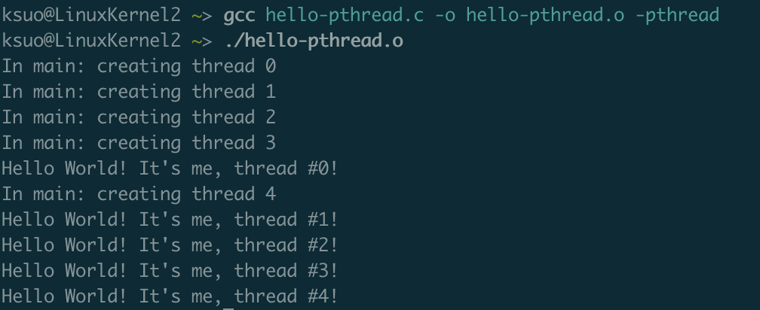
Execution
https://github.com/kevinsuo/CS3502/blob/master/hello-pthread.c
Run the output file
./hello-pthread.o

Slide 19
Example
https://github.com/kevinsuo/CS3502/blob/master/hello-pthread.c

Slide 20
1, Creation & Termination
pthread_create (thread, attr, thread_function, arg) 1st parameter: pthread in the array 3rd parameter: the function for the thread to run 4th parameter: arg is passed by reference as a pointer cast of type void
Initially, your main() program comprises a single, default thread.
e.g.,
pthread_t threads[NUM_THREADS];
int t;
for(t=0;t<NUM_THREADS;t++){
rc = pthread_create(&threads[t], NULL, thread_function, (void *)t);
}

Slide 21
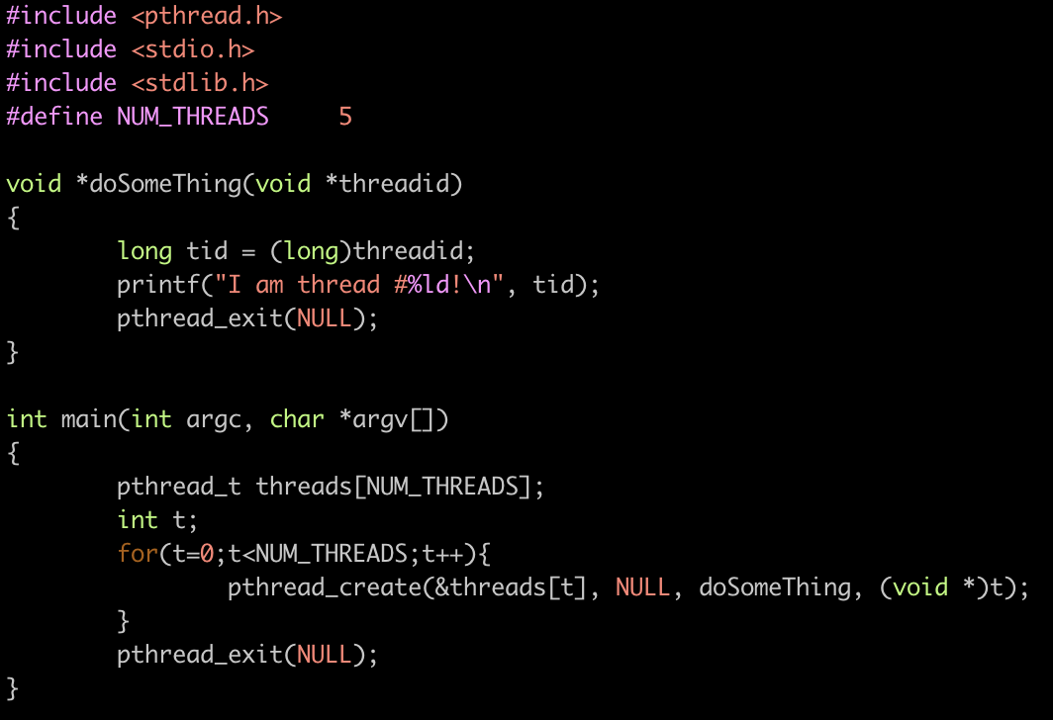
1, Creation example
https://github.com/kevinsuo/CS3502/blob/master/pthread_create_example.c
gcc pthread_create_example.c -o
pthread_create_example.o -pthread

Slide 22
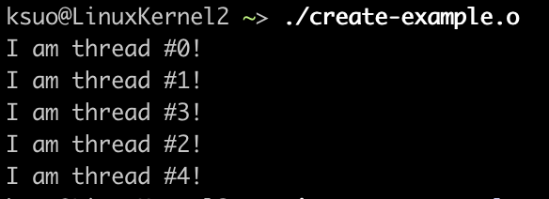
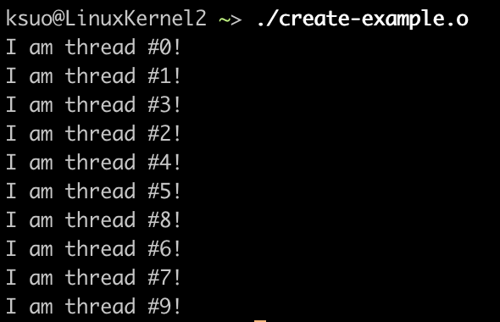
1, Creation example
$ gcc pthread_create_example.c -o create_example.o -pthread
NUM_THREADS=5
NUM_THREADS=10

Slide 23
1, Creation & Termination
pthread_exit (status) If main() finishes before the threads it has created, and exists with the pthread_exit(), the other threads will continue to execute. Otherwise, they will be automatically terminated when main() finishes
w/o pthread_exit()
w/ pthread_exit()
main
main
Child threads can still run at t1
create
create
Child
Child
t1
Child threads will end at t1
t1

Slide 24
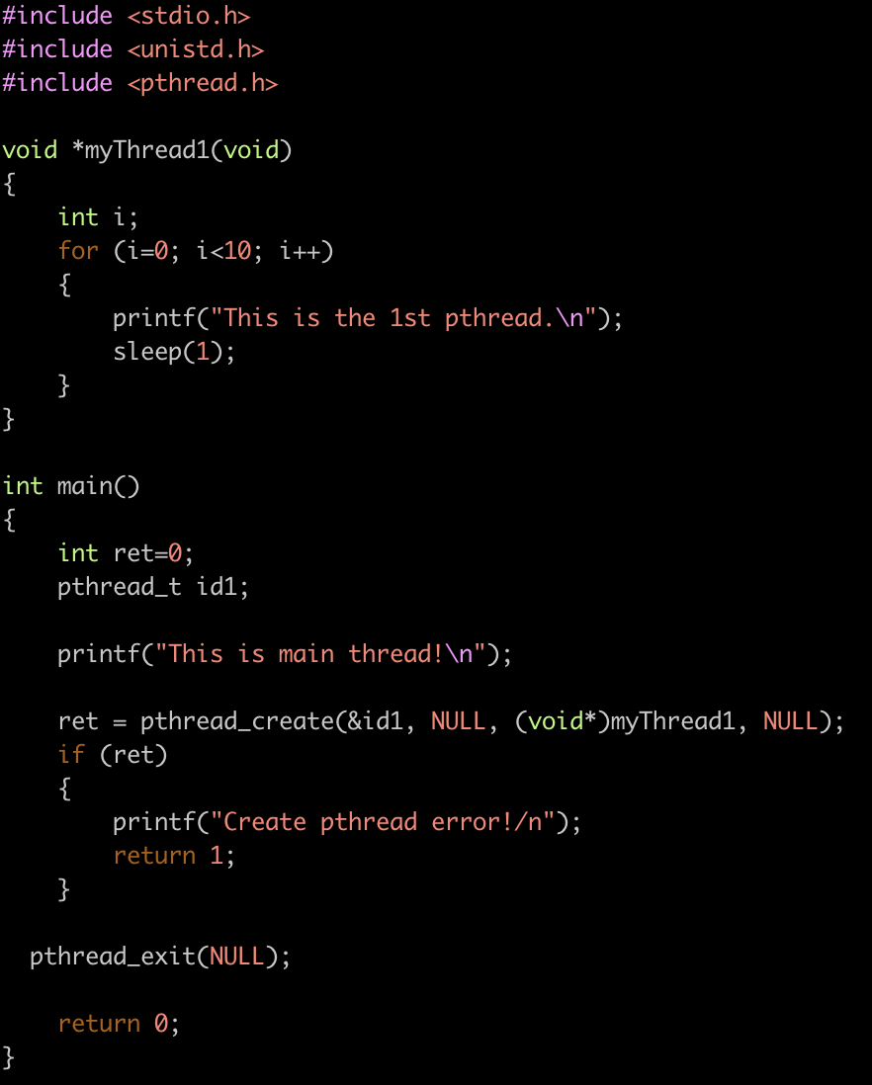
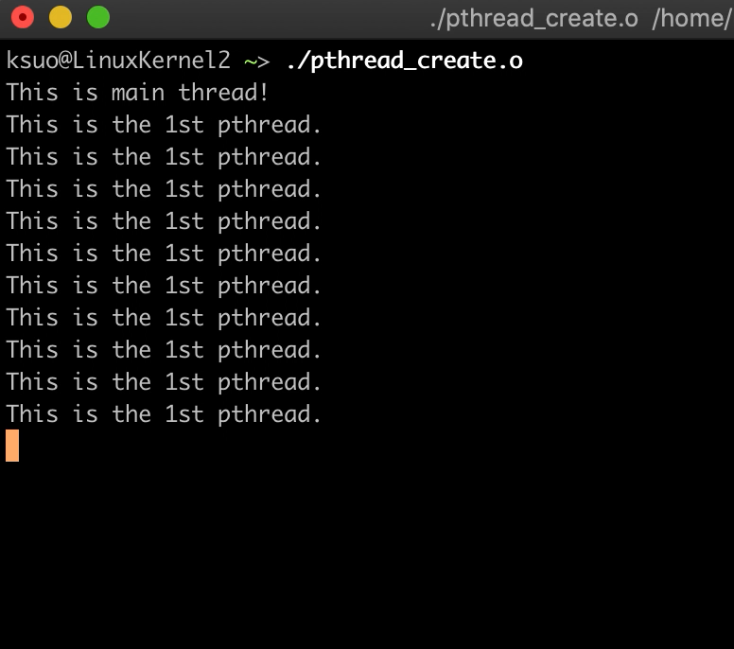
1, Termination example
https://github.com/kevinsuo/CS3502/blob/master/pthread_create.c
gcc pthread_create.c -o pthread_create.o -pthread
With it: Child threads will continue to run when the main thread ends.

Slide 25
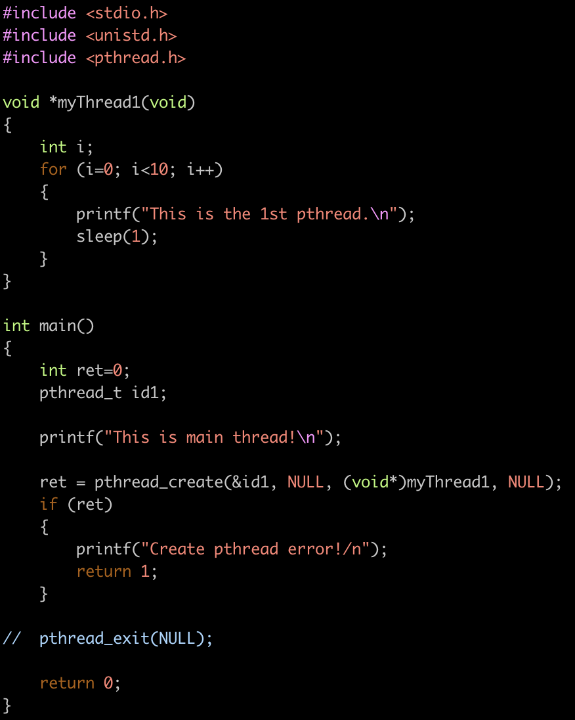
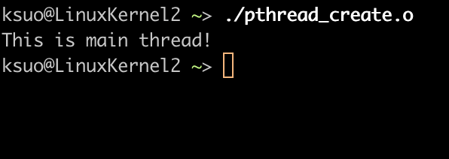
1, Termination example
https://github.com/kevinsuo/CS3502/blob/master/pthread_create.c
gcc pthread_create.c -o pthread_create.o -pthread
Without it: Child threads will end if the main thread ends.

Slide 26

2, identification
how to differentiate them?
Pthread_create

Slide 27
2, identification
pthread_self (void) returns the ID of the thread in which it is invoked.
A thread can obtain its own thread ID by calling the pthread_self() function

Slide 28
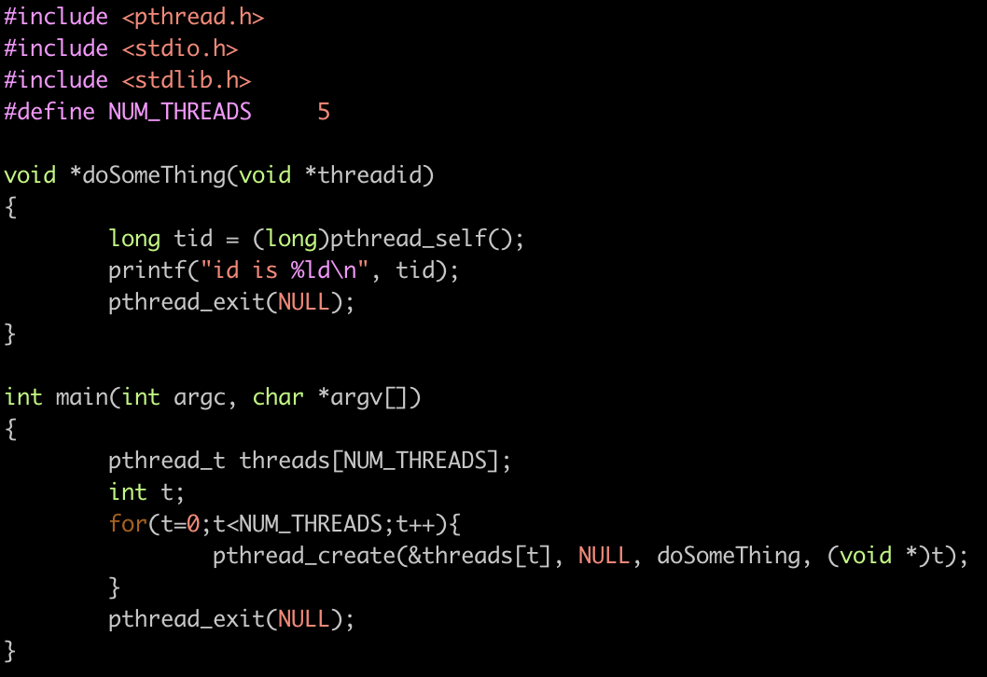
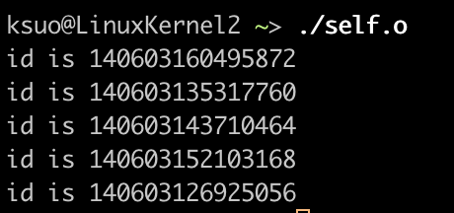
2, identification
https://github.com/kevinsuo/CS3502/blob/master/pthread_id.c
gcc pthread_id.c -o self.o -pthread

Slide 29
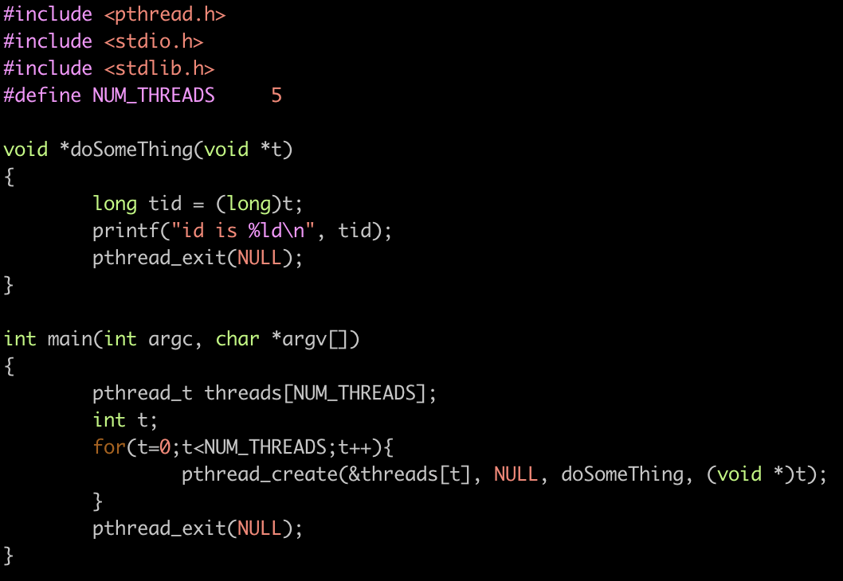
2, identification example
https://github.com/kevinsuo/CS3502/blob/master/pthread_id_2.c
gcc pthread_id_2.c –o pthread_id_2.o –pthread
arg can be used to differentiate threads

Slide 30
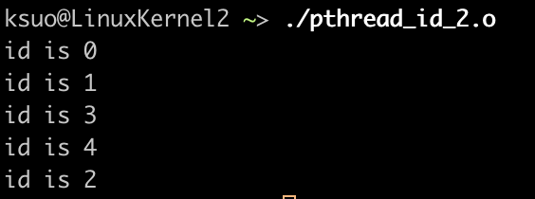
2, identification example
https://github.com/kevinsuo/CS3502/blob/master/pthread_id_2.c
Compile:
gcc pthread_id_2.c –o pthread_id_2.o –pthread
arg can be used to differentiate threads
Run:
./pthread_id_2.o

Slide 31
Question
1, can you start 10 threads to print out 10 strings?
2, can you let thread 0 print out “0 0 0” and let thread 1 to print out “1 1 1”?
3, array s[10]={1,2,3,4,5,6,7,8,9,10}, can you run 5 threads, each thread just does the sum up of two elements?

Slide 32
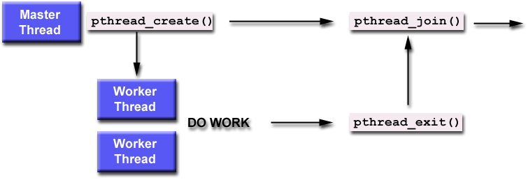
3, join
pthread_join (threadid, status) * Joining is one way to accomplish synchronization between threads: The pthread_join() subroutine blocks the calling thread until the specified threadid thread terminates.
The main thread will be blocked here to wait the child thread to finish
Main thread will wait here until the child thread finishes.

Slide 33
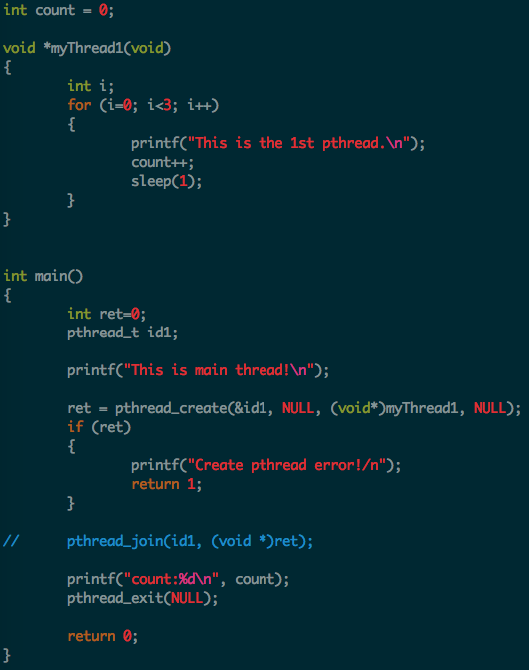
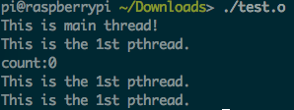
3, join example
https://github.com/kevinsuo/CS3502/blob/master/pthread_join.c
Compile:
gcc pthread_join.c –o pthread_join.o –pthread
Run:
./pthread_join.o
Count is 0 as the main thread keeps executing.

Slide 34
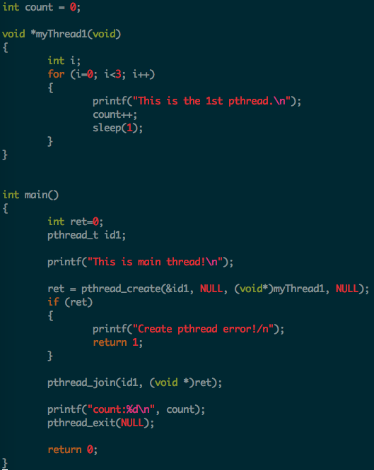
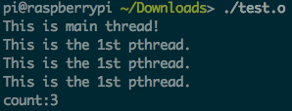
3, join example
https://github.com/kevinsuo/CS3502/blob/master/pthread_join.c
Compile:
gcc pthread_join.c –o pthread_join.o –pthread
Run:
./pthread_join.o
Count is 3 as the main thread is blocked here until child thread finished.

Slide 35
3, join example

Slide 36
Outline
What is pthread?
Thread model
Pthread overview
Pthread management
Creation and termination
Identification
Join and detach
Pthread data sharing
Mutex
Condition variable
Barrier
Semaphore

Slide 37
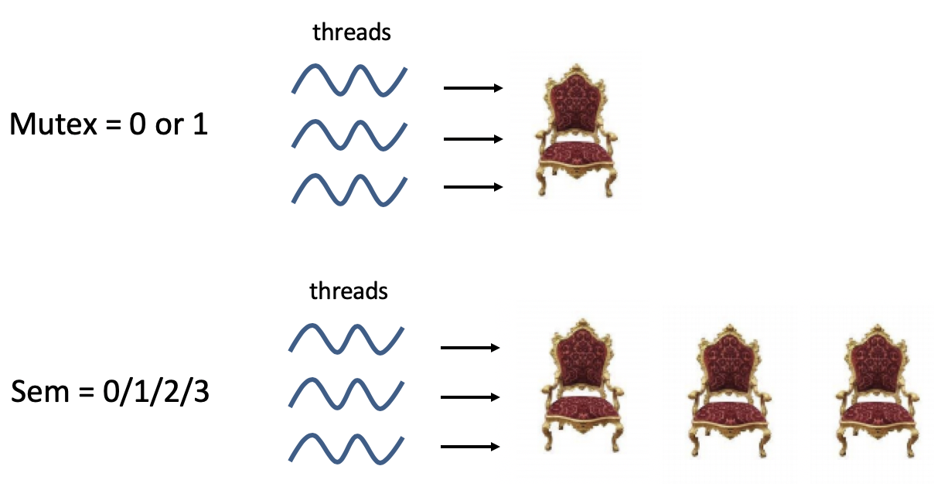
4, mutex lock
Mutex: a simplified version of the semaphores
A variable that can be in one of two states: unlocked or locked
Supports synchronization by controlling access to shared data

Slide 38
4, mutex – Creating and Destroying Mutexes
pthread_mutex_init (mutex, attr) pthread_mutex_destroy (mutex)
1. Mutex variables must be declared with type pthread_mutex_t, and must be initialized before can be used. The mutex is initially not locked. Statically: pthread_mutex_t mymutex = PTHREAD_MUTEX_INITIALIZER Dynamically, with pthread_mutex_init (mutex, attr) 2. The attr object must be declared with type pthread_mutexattr_t 3. Programmers should free a mutex object that is no longer used

Slide 39
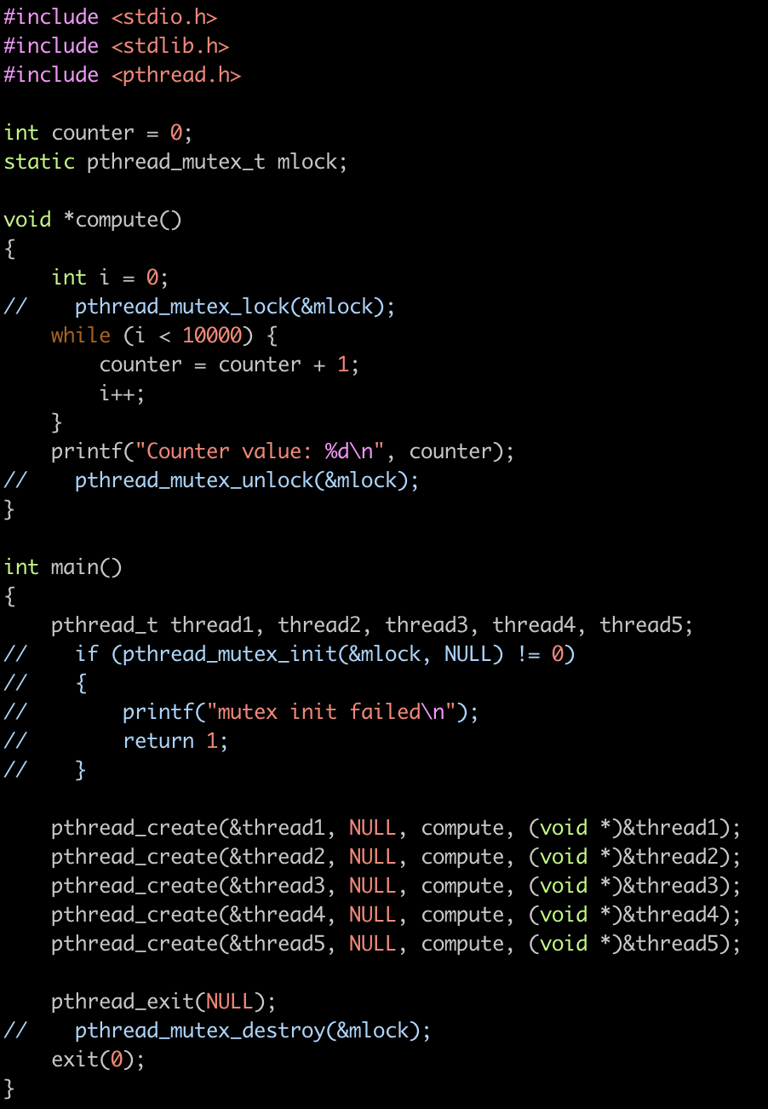
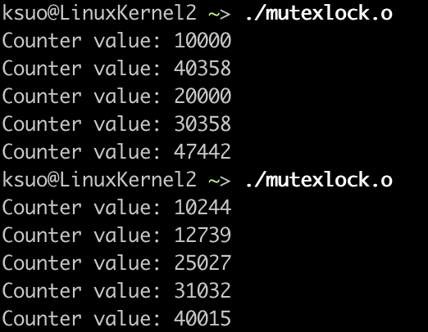
https://github.com/kevinsuo/CS3502/blob/master/mutexlock.c
Compile:
gcc mutexlock.c –o mutexlock.o –pthread
Run:
./mutexlock.o

Slide 40
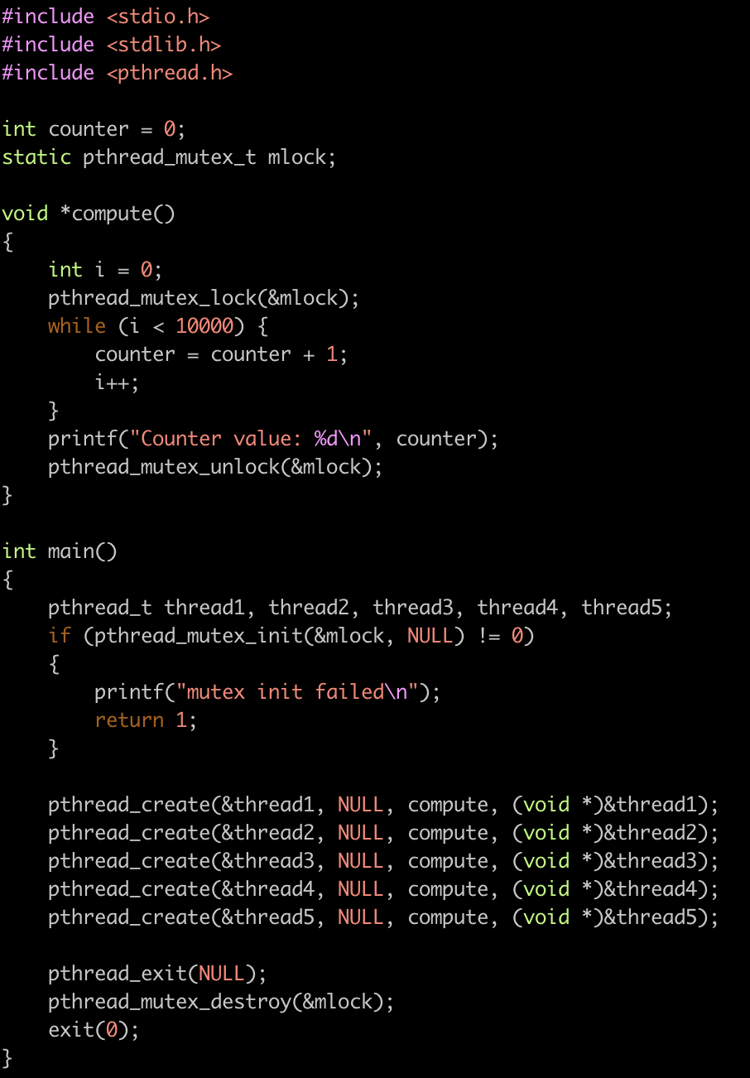
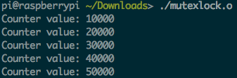
https://github.com/kevinsuo/CS3502/blob/master/mutexlock.c
Compile:
gcc mutexlock.c –o mutexlock.o –pthread
Run:
./mutexlock.o
Init the mutex lock
destroy the mutex lock

Slide 41
5, mutex – Locking and Unlocking of Mutexes
pthread_mutex_lock (mutex) ; P(down) pthread_mutex_trylock (mutex) pthread_mutexattr_unlock (mutex) ; V(up)
1. pthread_mutex_lock (mutex) is a blocking call. 2. pthread_mutex_trylock (mutex) is a non-blocking call, useful in preventing the deadlock conditions (priority-inversion problem) 3. If you use multiple mutexes, the order is important;

Slide 42
https://github.com/kevinsuo/CS3502/blob/master/mutexlock.c
Lock the “counter”
Critical section
Unlock the “counter”

Slide 43
pthread_mutex_lock vs. pthread_mutex_trylock
https://github.com/kevinsuo/CS3502/blob/master/lock.c
pthread_mutex_lock (mutex) is a blocking call.
1st lock. Get the lock.
pthread_mutex_lock
2rd lock. Blocked here.
pthread_mutex_lock
Critical section

Slide 44
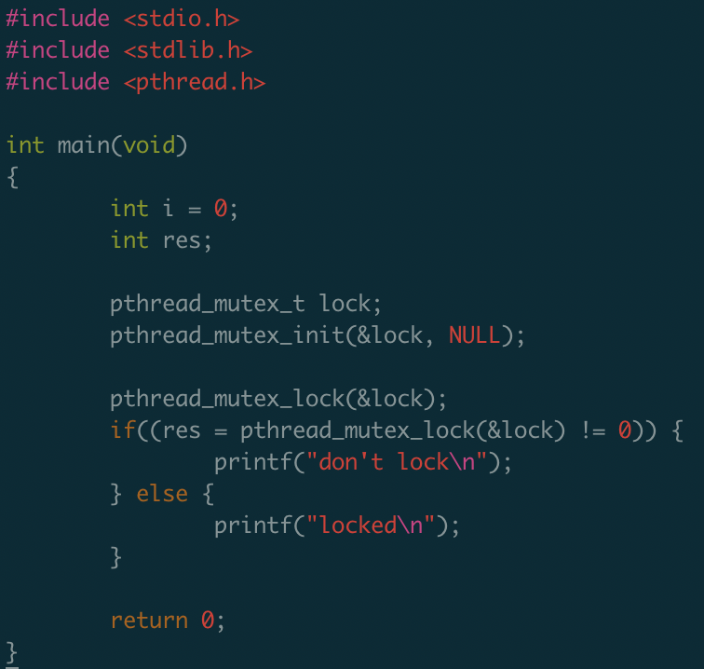
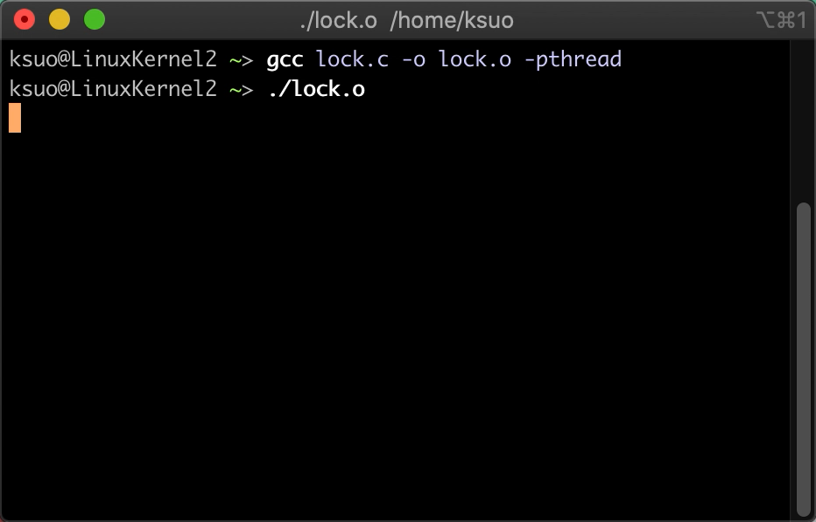
pthread_mutex_lock vs. pthread_mutex_trylock
https://github.com/kevinsuo/CS3502/blob/master/lock.c
pthread_mutex_lock (mutex) is a blocking call.
1st lock. Get the lock.
2rd lock. Blocked here.

Slide 45
pthread_mutex_lock vs. pthread_mutex_trylock
https://github.com/kevinsuo/CS3502/blob/master/lock.c
pthread_mutex_lock (mutex) is a blocking call.
1st lock. Get the lock.
pthread_mutex_trylock
2rd lock. Not Blocked here.
pthread_mutex_trylock
Critical section

Slide 46
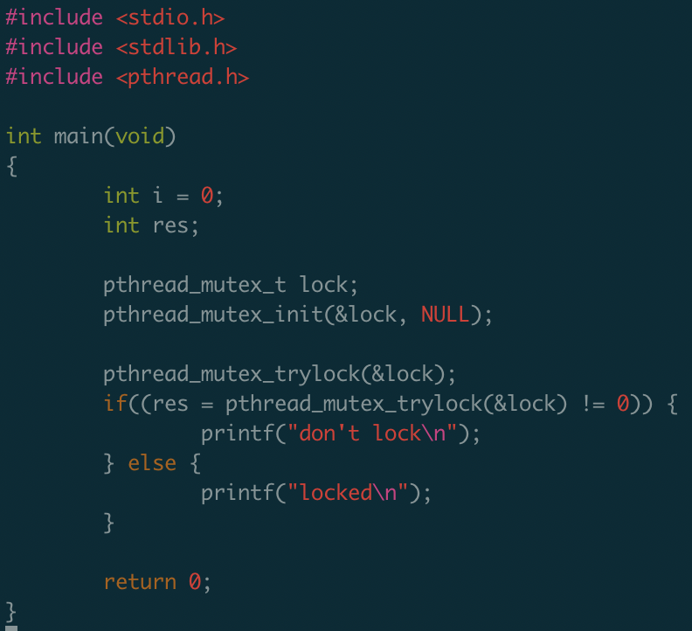
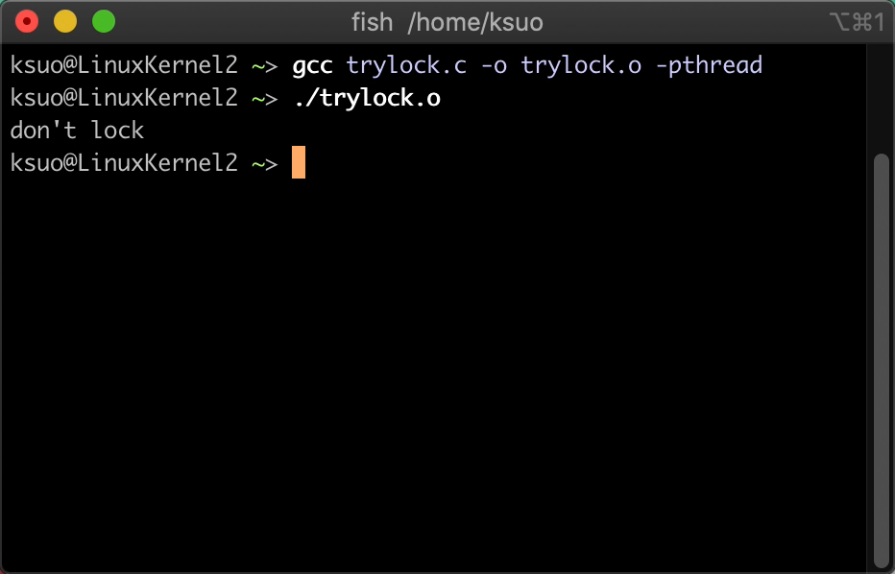
pthread_mutex_lock vs. pthread_mutex_trylock
https://github.com/kevinsuo/CS3502/blob/master/trylock.c
pthread_mutex_trylock (mutex) is a non-blocking call.
1st lock. Get the lock.
2rd lock. Not blocked here.

Slide 47
6, Condition variable
Mutexes: support synchronization by controlling thread access to data (without conditions)
Condition variables: another way for threads to synchronize (with conditions)
Example:
T1: increase x every time;
T2: when x is larger than 99,
then set x to 0;
Thread 1
Critical section
x
Thread 2
I only visited critical section when x >= 100

Slide 48
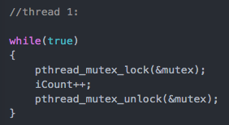
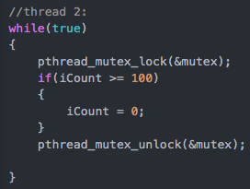
6, condition variable example
https://github.com/kevinsuo/CS3502/blob/master/lock_wo_condition.c
Mutex without condition
Example: T1: increase x every time;
T2: when x is larger than 99, then set x to 0;
T2 needs to:
lock;
determine;
unlock;
every time to check

Slide 49
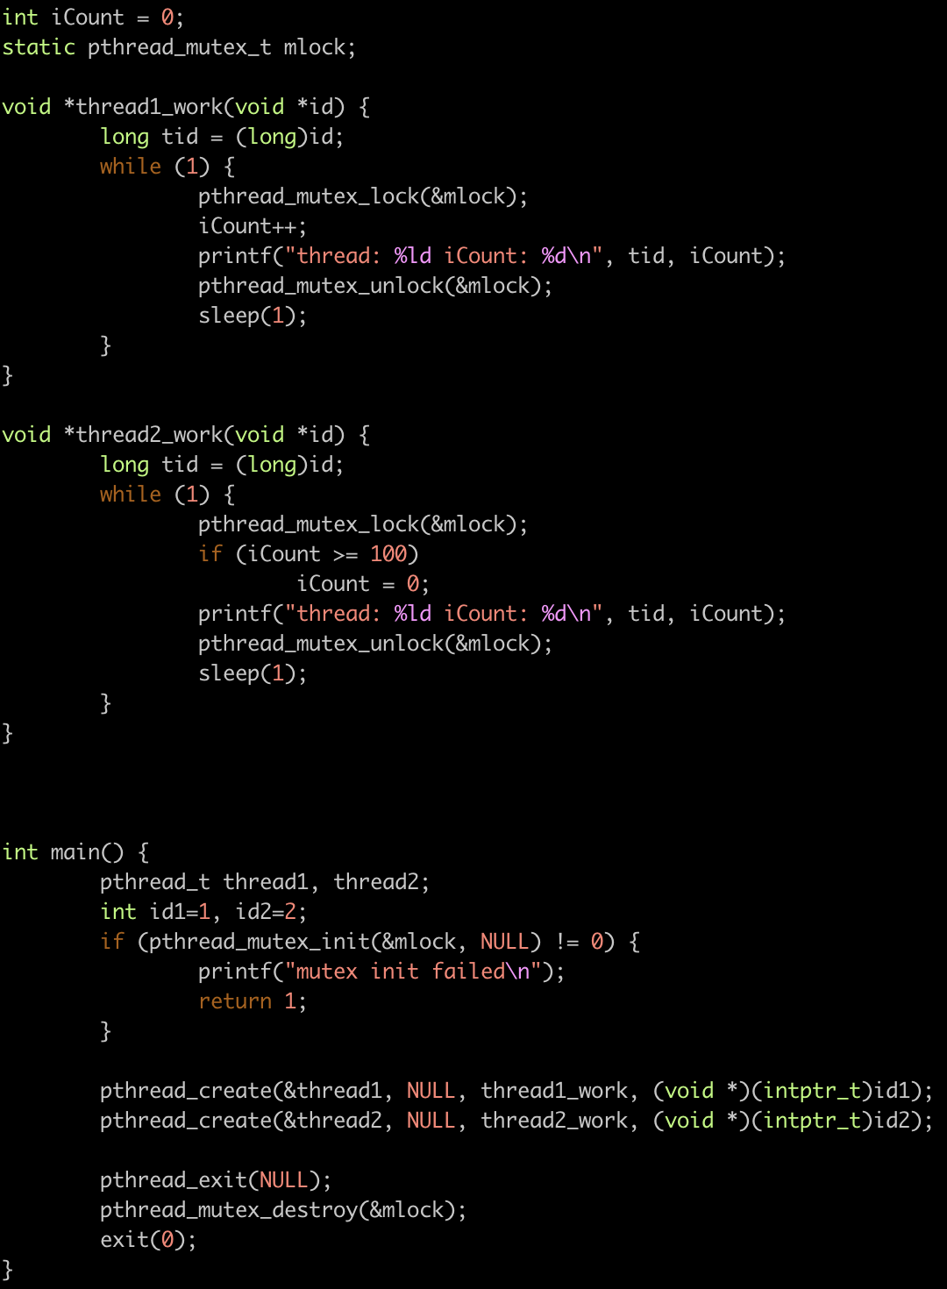
6, condition variable example
https://github.com/kevinsuo/CS3502/blob/master/lock_wo_condition.c

Slide 50
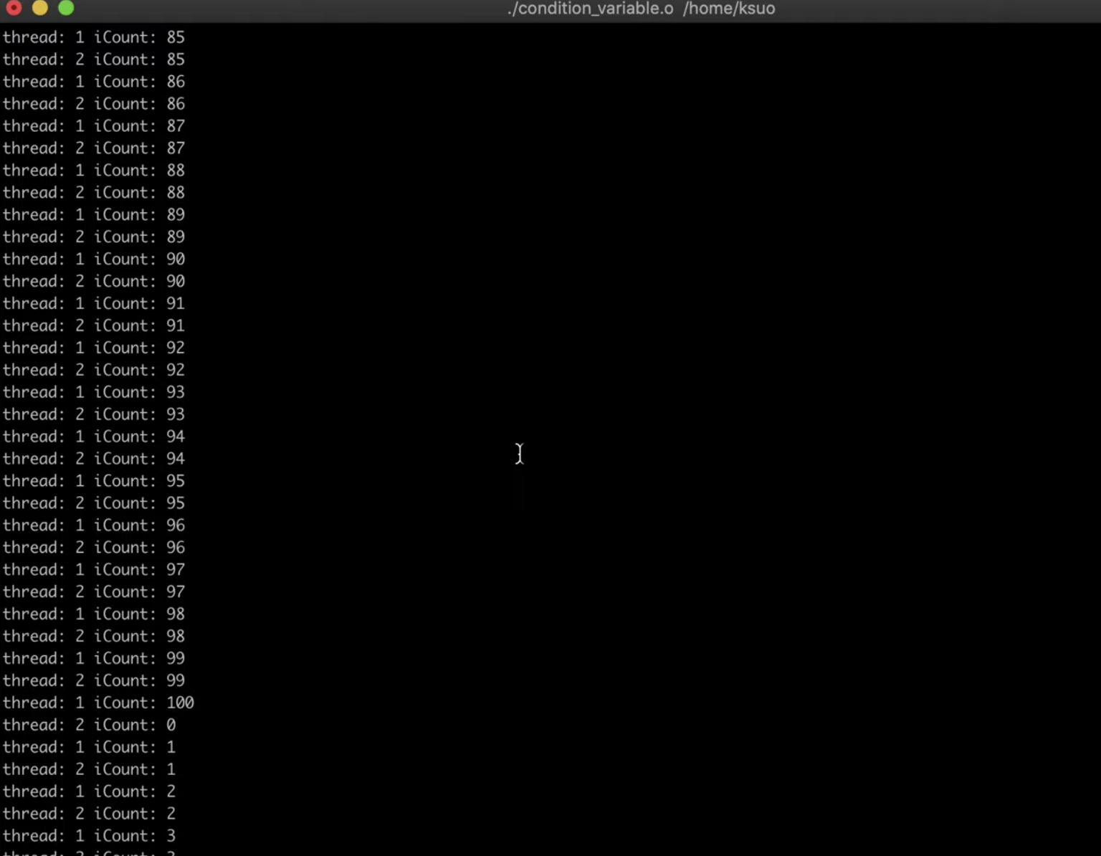
6, condition variable example
https://github.com/kevinsuo/CS3502/blob/master/lock_wo_condition.c
gcc lock_wo_condition.c -o lock_wo_condition.o -pthread
./lock_wo_condition.o
https://www.youtube.com/watch?v=GADpqSLHcPM

Slide 51
6, condition variable – Waiting and Signaling Con. Variables
pthread_cond_wait (condition, mutex) pthread_cond_signal (condition) pthread_cond_broadcast (condition)
1. wait() blocks the calling thread until the specified condition is signaled. It should be called while mutex is locked 2. signal() is used to signal (or wake up) another thread which is waiting on the condition variable. It should be called after mutex is locked, and programmers must unlock mutex in order for wait() routine to complete 3. broadcast() is useful when multiple threads are in blocked waiting 4. wait() should come before signal() – conditions are not counters, signal would be lost if not waiting

Slide 52
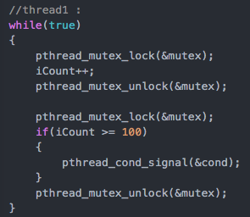
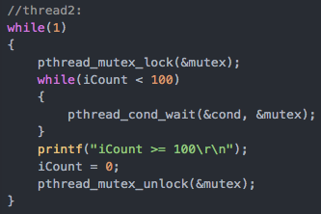


6, condition variable example
https://github.com/kevinsuo/CS3502/blob/master/lock_w_condition.c
Mutex with condition
Example: T1: increase x every time;
T2: when x is larger than 99, then set x to 0;
1. Get the
1. Get the
2. release the
2. release the
3. Get the
3. Get
4. release the
4. release the

Slide 53
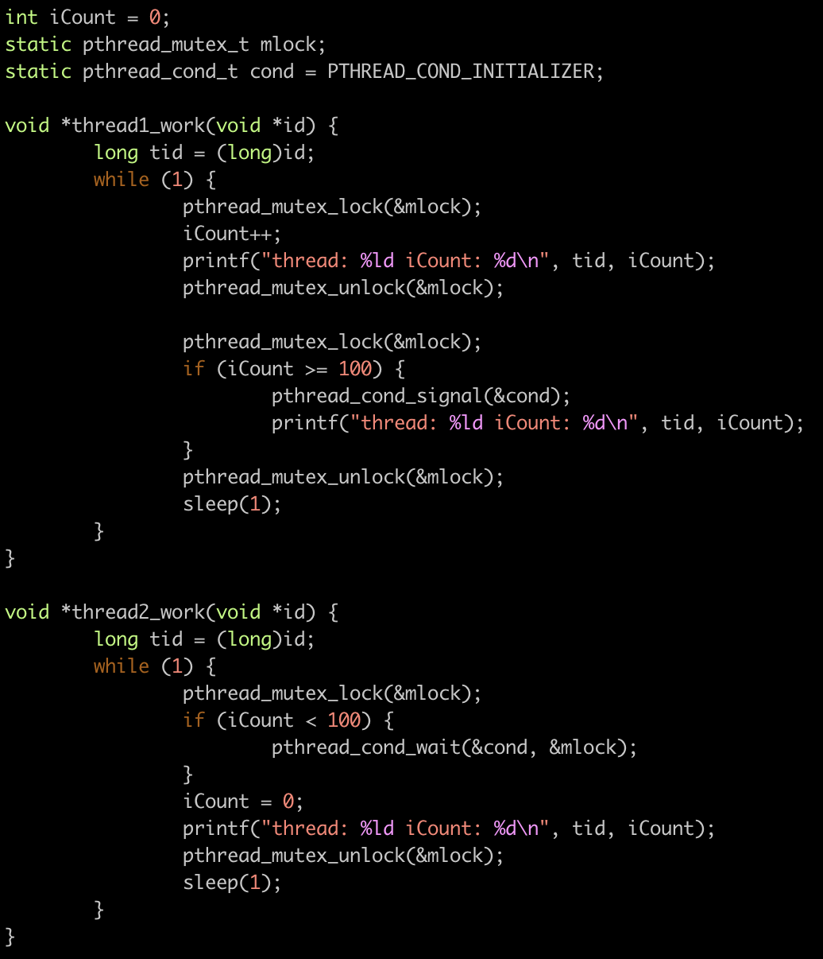
6, condition variable example
https://github.com/kevinsuo/CS3502/blob/master/lock_w_condition.c

Slide 54
6, condition variable example
https://github.com/kevinsuo/CS3502/blob/master/lock_w_condition.c
gcc lock_w_condition.c -o lock_w_condition.o –pthread
./lock_w_condition.o

Slide 55
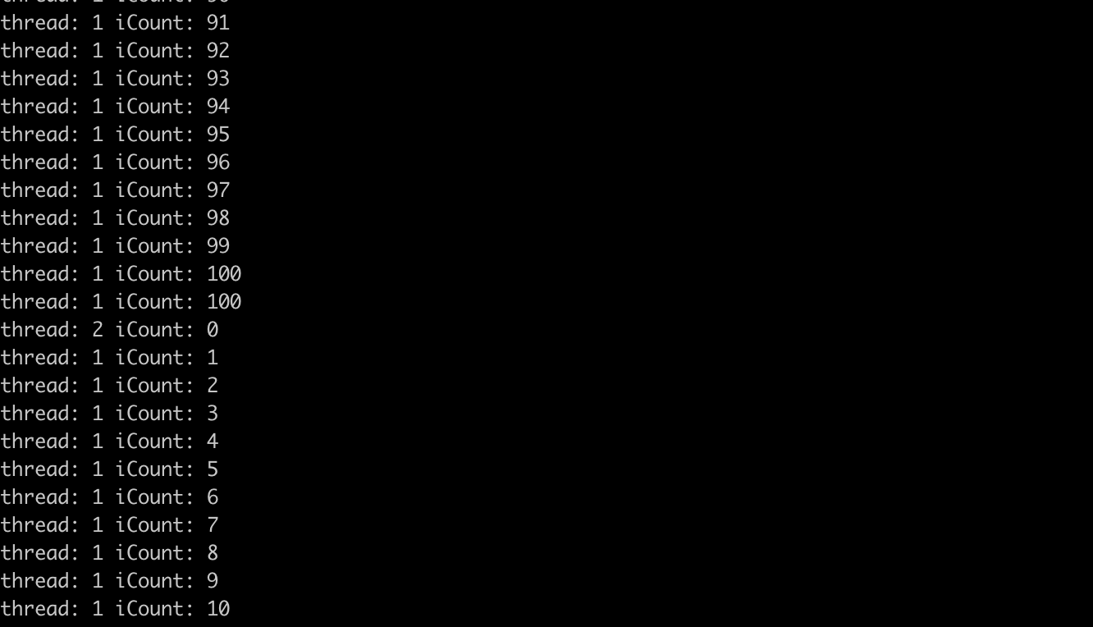
6, condition variable example
https://github.com/kevinsuo/CS3502/blob/master/lock_w_condition.c
gcc lock_w_condition.c -o lock_w_condition.o –pthread
./lock_w_condition.o
https://www.youtube.com/watch?v=81CFeuKRscw

Slide 56
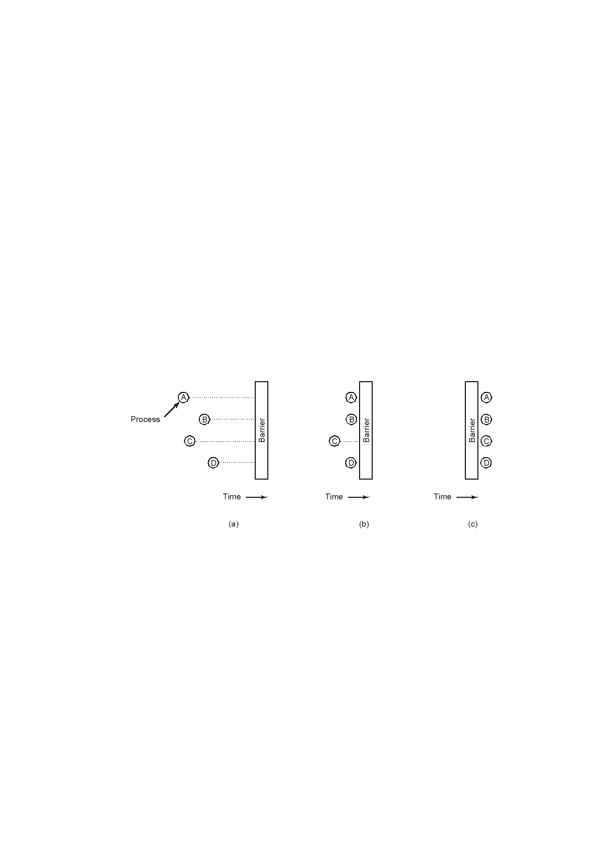
7, barriers
Use of a barrier (for programs operate in phases, neither enters the next phase until all are finished with the current phase) for groups of processes to do synchronization
(a) processes approaching a barrier
(b) all processes but one blocked at barrier
(c) last process arrives, all are let through

Slide 57
7, barriers – Initializing and waiting on barriers
pthread_barrier_init (barrier, attr, count) pthread_barrier_wait (barrier) pthread_barrier_destroy (barrier)
1. init() function shall allocate any resources required to use the barrier referenced by barrier and shall initialize the barrier with attr. If attr is NULL, default settings will be applied. The count argument specifies the number of threads that must call wait() before any of them successfully return from the call. 2. wait() function shall synchronize participating threads at the barrier. 3. destroy() function shall destroy the barrier and release any resources used by the barrier.

Slide 58
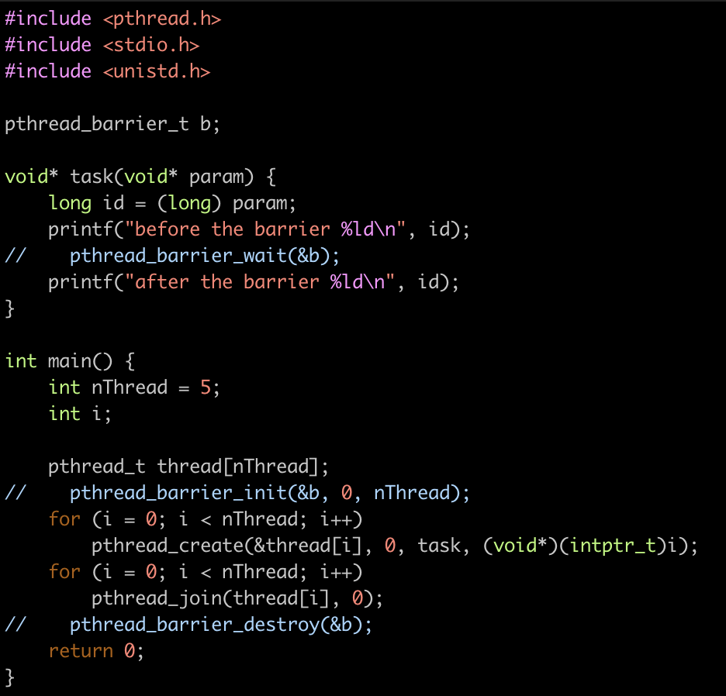
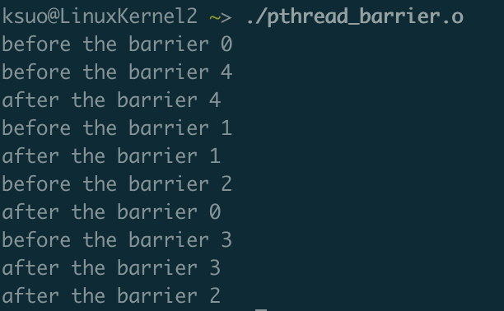
7, without barriers example
https://github.com/kevinsuo/CS3502/blob/master/pthread_barrier.c
Some “after” appears ahead of “before”

Slide 59
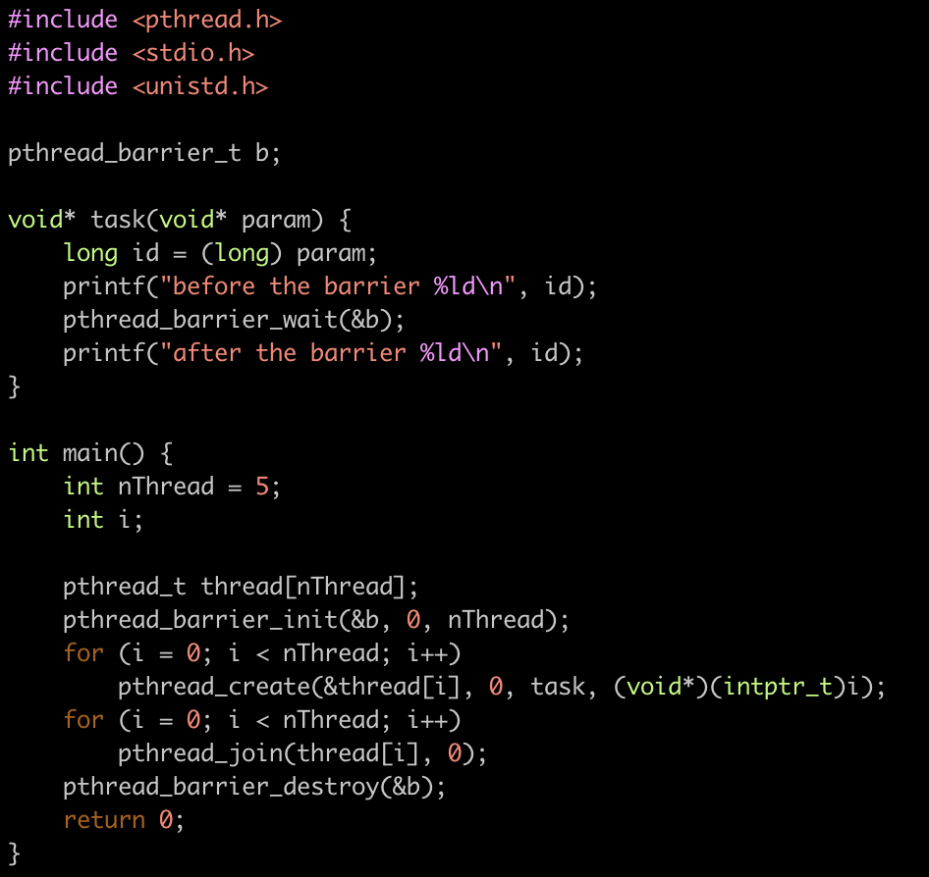
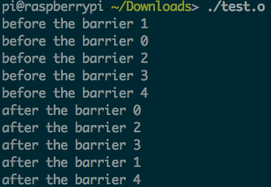
7, barriers example
https://github.com/kevinsuo/CS3502/blob/master/pthread_barrier.c
All threads are waiting here.
Create barrier
Destroy barrier

Slide 60
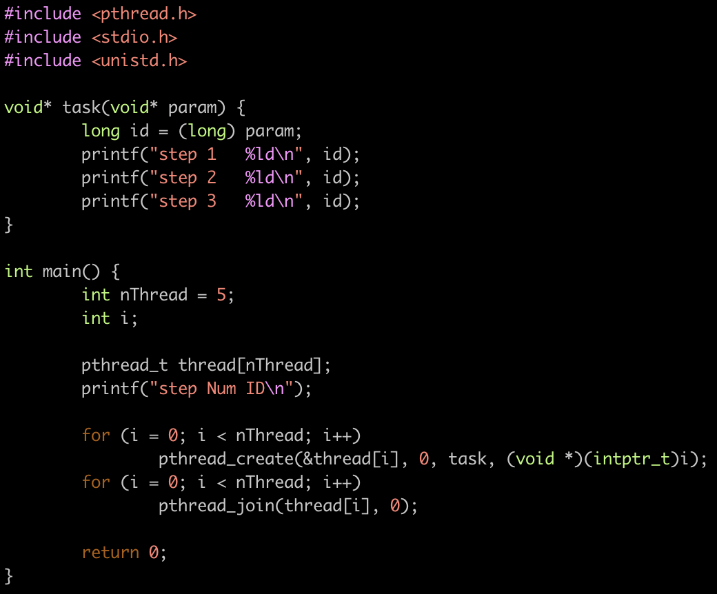
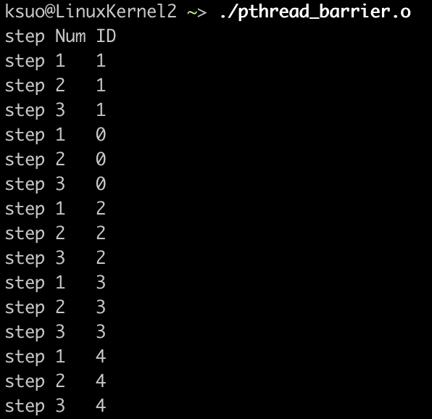
Question
https://github.com/kevinsuo/CS3502/blob/master/pthread_barrier_test.c
1
2
3

Slide 61


Question
1
2
3

Slide 62
Question
Can you use pthread_barriers to replace the pthread_join?
Main thread will wait here until the child thread finishes.

Slide 63

Question
https://github.com/kevinsuo/CS3502/blob/master/pthread_join.c

Slide 64

Question
https://github.com/kevinsuo/CS3502/blob/master/pthread_join.c

Slide 65

Question
Can you use pthread_barriers to replace the pthread_join?

Slide 66

8, semaphore
Semaphores are counters for resources shared between threads. The basic operations on semaphores are: increment the counter atomically, and wait until the counter is non-null and decrement it atomically.

Slide 67

Semaphore
Down operation (P; request):
Checks if a semaphore is > 0, sem--
Request one unit resource and one process enters
Up operation (V; release)
sem++
Release one unit resource and one process leaves

Slide 68


8, semaphore
int sem_init (sem_t *sem, int pshared, unsigned int value) //Init a sem. The pshared argument indicates whether this semaphore is to be shared between the threads of a process (pshared=0), or between processes (pshared$≠$0). The value argument specifies the initial value for the semaphore (how many resources). int sem_destroy (sem_t * sem) //Destroy a sem int sem_wait (sem_t * sem) //Request one unit resource, blocking call. If successful, sem--. int sem_trywait (sem_t * sem) //Request one unit resource, non-blocking call. If successful, sem--. int sem_post (sem_t * sem) //Release one unit resource. If successful, sem++.

Slide 69

Semaphore example
https://github.com/kevinsuo/CS3502/blob/master/semaphore.c
Semaphore:
Son: whether there is pear, s1
Daughter: whether there is apple, s2
Father/Mother: whether there is space, s3
Father thread:
peel apple
P(s3)
put apple
V(s2)
Mother thread:
peel pear
P(s3)
put apple
V(s1)
Son thread:
P(s1)
get pear
V(s3)
eat pear
Daughter thread:
P(s2)
get apple
V(s3)
eat apple

Slide 70


Semaphore example
https://github.com/kevinsuo/CS3502/blob/master/semaphore.c
Semaphore:
Son: whether there is pear, s1
Daughter: whether there is apple, s2
Father/Mother: whether there is space, s3
Father thread:
peel apple
P(s3)
put apple
V(s2)
Daughter thread:
P(s2)
get apple
V(s3)
eat apple
P(s2)
P(s3)
V(s3)
V(s2)

Slide 71


Semaphore example
https://github.com/kevinsuo/CS3502/blob/master/semaphore.c
Semaphore:
Son: whether there is pear, s1
Daughter: whether there is apple, s2
Father/Mother: whether there is space, s3
Mother thread:
peel pear
P(s3)
put apple
V(s1)
Son thread:
P(s1)
get pear
V(s3)
eat pear
P(s1)
P(s3)
V(s3)
V(s1)

Slide 72

Semaphore:
Son: whether there is pear, s1
Daughter: whether there is apple, s2
Father/Mother: whether there is space, s3
https://github.com/kevinsuo/CS3502/blob/master/semaphore.c
remain is semaphore
nremain is an integer
remain is semaphore
nremain is a integer
Computer Science

Slide 73


Semaphore example
https://github.com/kevinsuo/CS3502/blob/master/semaphore.c

Slide 74

Semaphore example
https://github.com/kevinsuo/CS3502/blob/master/semaphore.c
gcc -pthread semaphore.c -o semaphore.o
https://youtu.be/ZIWwvcuROME

Slide 75
Conclusion
What is pthread?
Thread model
Pthread overview
Pthread management
Creation and termination
Identification
Join and detach
Pthread data sharing
Mutex
Condition variable
Barrier
Semaphore

Slide 76
Semaphore example
H, H
O
H₂O
Semaphore h = 0; Semaphore o = 0;
//executed when H is available hReady() { //h++ V(h); //request O; if succeed, O--; otherwise, sleep&wait P(o); return; } | //executed when O is available oReady() { //o++ V(o); //request h; if succeed, h--; otherwise, sleep&wait P(h); P(h); //make H₂O makeWater(); return; }

Slide 77
Compiling Pthreads Programs
Platform | Compiler Command | Description
IBM AIX | xlc_r / cc_r | C (ANSI / non-ANSI)
 | xlC_r | C++
 | xlf_r -qnosave xlf90_r -qnosave | Fortran - using IBM's Pthreads API (non-portable)
INTEL LINUX | icc -pthread | C
 | icpc -pthread | C++
COMPAQ Tru64 | cc -pthread | C
 | cxx -pthread | C++
All Above Platforms | gcc -lpthread/pthread | GNU C
 | g++ -lpthread/pthread | GNU C++
 | guidec -pthread | KAI C (if installed)
 | KCC -pthread | KAI C++ (if installed)

Slide 78
4, detach
The default state of a thread is joinable. If a thread finishes but is not joined, its state is similar to the zombie process, which is, some resources are not recycled.
finish
create
execute
wait for join
joinable
thread
thread
zombie
finish
release resource
create
execute
detached
thread
thread

Slide 79



4, detach example
https://github.com/kevinsuo/CS3502/blob/master/pthread_detach.c
Resources will not be released after execution.

Slide 80

4, detach example
https://github.com/kevinsuo/CS3502/blob/master/pthread_detach.c
Set itself not joinable
Resources will be released.

Slide 81


4, mutex
A typical sequence in the use of a mutex
Create and initialize a mutex variable
Several threads attempt to lock the mutex
Only one succeeds and that thread owns the mutex
The owner thread performs some set of actions
The owner unlocks the mutex
Another thread acquires the mutex and repeats the process
Finally the mutex is destroyed
1
2
3

